Slide 1
TypeScript
Part-001

Slide 2
Objectives
Understand TypeScript fundamentals and type system.
Write type-safe functions and classes
Use types, interfaces, and enums effectively
Notes:
https://www.javabrahman.com/java-8/java-8-java-util-stream-collector-basics-tutorial-with-examples/
https://www.journaldev.com/2763/java-8-functional-interfaces
http://winterbe.com/posts/2014/03/16/java-8-tutorial/
https://www.oreilly.com/learning/java-8-functional-interfaces

Slide 3
Declaring Variables
Declaration of a variable is used to assign a data type and an identifier to a variable. Declaration of variables in TypeScript is like JavaScript variable declaration.
Below are the three declaration types supported in TypeScript.
Data Type | Explanation
var | Variable declared with this type would have function scope. They can be re-assigned and re-defined. When a variable declared outside the function, it would have global scope and automatically attaches itself to the window object.
let | Variable declared with this type would have a block-level scope. They can be re-assigned and cannot be redefined.
const | Variable declared with this type would have a block-level scope. They can be neither re-assigned nor re-defined.

Slide 4
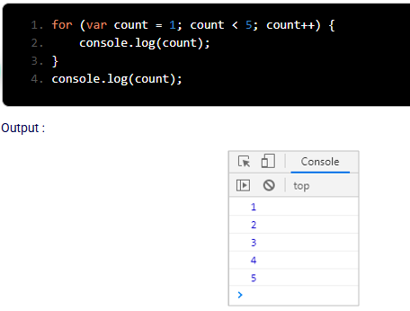
Problem with var declaration:
In the below code, a strange behavior of the variable count can be observed.
This variable can be accessed even outside the loop although it is defined inside the loop.
This is due to the global scope nature of the var data type declaration.

Slide 5
Problem with var declaration:
Some of the other problems with global scope variable are:
When the var declared variable is defined outside a function it is attached with the window object which has only one instance.
This is a bad practice and causes an overridden of a variable when you try to use a third-party library working with the same variable.
Generally, var variables have a function-scope and if they are not declared within a function, they have a global scope.
To overcome this issue, in ES2015. JavaScript has introduced let and const as two new declaration types and it is considered as standard because declaring variables by these two data types are safer than declaring a variable using the var keyword.

Slide 6
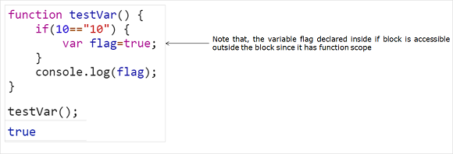
let and const keywords
ECMAScript 6 introduces two new keywords to declare variables: let and const.
Unlike variables declared with var are function-scoped, variables declared with let and const are block-scoped.
They exist only in the block in which they are defined.
Consider the below example:

Slide 7
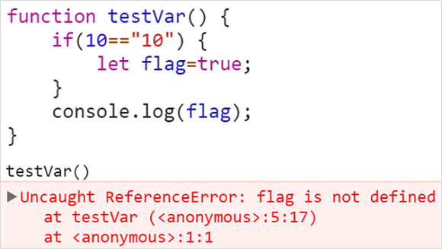
let and const keywords
Modifying the code to use let variable will result in following error:
The usage of ‘let’ in the above code snippet has restricted the variable scope only to if block.

Slide 8
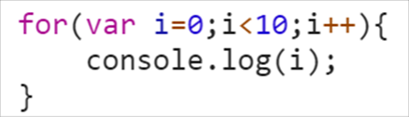
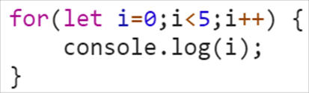
let and const keywords
Looping variables are never accessed outside the block. Using ‘var’ extends the variables scope in memory beyond its need.
Use let to restrict the scope to block level.

Slide 9
Difference between var and let Keyword
When to use ‘let’ ?
When you don't need the variable outside the code block.
When you are looping, and looping variables are never used outside the block.
To restrict the scope to the block level.
When the value assigned to the variable can change.
Var | Let and Const
Globally available in the function where it is declared | Only available in the code block where it is declared
Hoisted to the top of the function | Not hoisted to the top of the block
Variable name can be declared second time in the same function | Can be declared only once per block

Slide 10
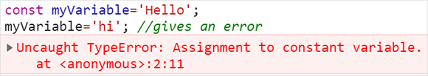
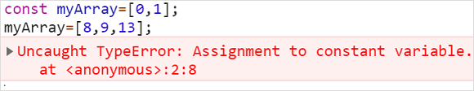
Difference between var and let Keyword
When to use ‘const’ ?
const is to be used in place of ‘let’ when the variable value should remain constant and shouldn’t be allowed to change throughout the program.
const has same scope as that of ‘let’ i.e. block scope.
const keyword can also be used for arrays and other objects.
Arrays and objects are of reference type and hence the reference is considered constant and can not be changed once defined. However the below line will not throw any error as we do not attempt to change the reference.

Slide 11
Basic Types
Data type mentions the type of value assigned to a variable. It is used for variable declarations.
Since TypeScript supports static typing, the data type of the variable can be determined at the compilation time itself.
The different data types available in TypeScript are
boolean
number
string
any
void
never
readonly
symbol

Slide 12
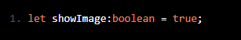
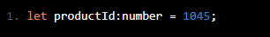
boolean and number
boolean:
boolean is a data type that accepts only true or false as a value for the variable it is been declared.
In a shopping cart application, a boolean type variable can be used to check for the product availability, to show/hide the product image, etc.
number:
number type represents numeric values. All TypeScript numbers are floating-point values.
In a shopping cart application, number type can be used to declare the Id of a product, price of a product, etc.

Slide 13

string
string:
A string is used to assign textual values or template strings. String values are written in quotes – single or double.
In a mCart application, string type can be used to declare variables like productName, productType, etc.

Slide 14
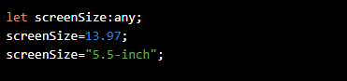
any
any:
any type is used to declare a variable whose type can be determined dynamically at runtime with the value supplied to it. If no type annotation is mentioned while declaring the variable, any type will be assigned by default.
In a mCart application, any type can be used to declare a variable like screenSize of a Tablet.
In the above code snippet
Line no 2 - screenSize variable is assigned numeric value.
Line no 3 - screenSize variable is assigned string value , which is acceptable since data type is any.

Slide 15
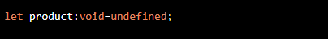
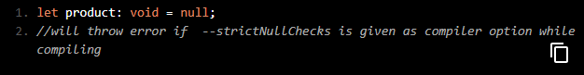
void
void:
void is basically used to represent no data. A variable can be declared with void type as below:
In the above example, the variable ‘product’ is declared with void datatype. void type is not preferred for variable declaration as it can be assigned only with undefined and null as the value. But if the compiler option ---strictNullChecks is provided, then the assignment of null value to a void type will throw error.

Slide 16
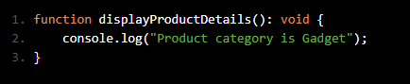
void
void type is commonly used to specify the function return type. The function which does not return a value can be declared with a void return type. If the function doesn't return any value, then TypeScript automatically infers the return type as void.

Slide 17
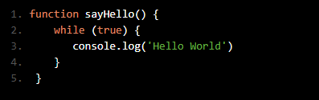
never:
never is a new data type introduced in TypeScript in the year 2016. This data type indicates that the situation will never occur. It can be used in functions that run in infinite loop or that in which the end of function is not reached at all.
Consider a function which executes recursively as shown below:
In the above-given code sayHello() function consists of while loop at Line no 2 that executes infinitely within the loop and prints “Hello World” message in the default console but will never come out of the function. Hence, never type can be added to it to indicate that it will never come out of the function.

Slide 18
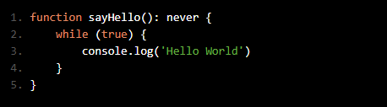
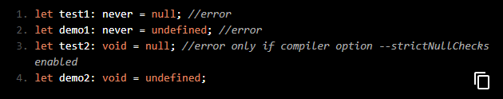
never:
The difference between void and never is that never does not take null and undefined as values, but void does take null and undefined as values.
For example:

Slide 19
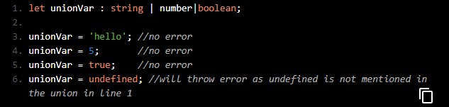
union:
In TypeScript, it is also possible to declare that a variable can take value belonging to one of the data types from a previously defined set. The set of data types are added using | symbol (union operator).
In the above example, line number 1 declares that the variable unionVar can take string, number or boolean type as its value. Hence no error is thrown at line numbers 3,4 and 5. But line number 6 throws error as defined data type is note mentioned at line number 1 as part of the union.

Slide 20
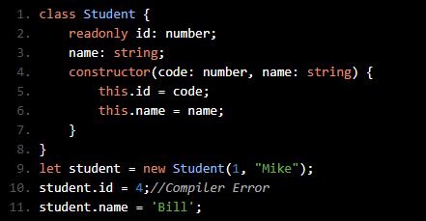
readonly :
“readonly” keyword can be used with the properties of class, type or interface in any TypeScript application development.
These members are normally assigned within the constructor of the class.
They cannot be modified outside the class but can be accessed outside the class.
Class readonly :

Slide 21
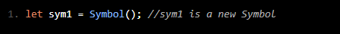
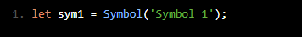
Symbol :
A ‘Symbol’ represents a unique identifier. Use the Symbol() to generate a value of this type.
Also, a description of the symbol generated can be provided which can be mostly used as a name during debugging.
If two symbols are compared, they will always be unique and immutable. Even if various symbols are created with same description, they are different values. Thus, symbols ensure uniqueness. So, the description provided can be considered as just a label.

Slide 22
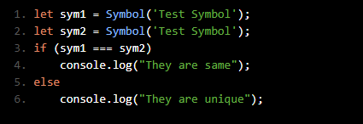
Symbol :
Consider the below-given code:
As in Line no 3 while comparing both symbols, by default, code will always return ‘They are unique’ message.
Also, unlike other types, developers are not provided with any built-in support for methods or properties declarations using the Symbol datatype.

Slide 23
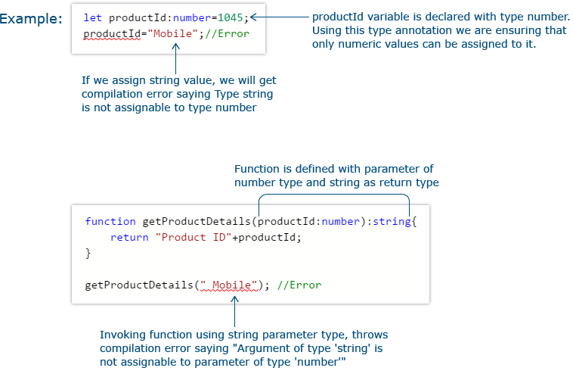
Type Annotation
Type Annotation is a way to enforce type restriction to a specific variable or a function. If a variable is declared with a specific data type and another type of value is assigned to the variable, a compilation error will be thrown.

Slide 24
Enum
Enum in TypeScript is used to give more friendly names to a set of numeric values.
For example, to store a set of size variables such as Small, Medium and Large with different numeric values, group those variables under a common Enum called Size.
By default, Enum’s first item will be assigned with zero as the value and the subsequent values will be incremented by one.
Syntax:
In the mCart application, a MobilePrice enum can be used to store different prices of the mobile depending on the mobile color.

Slide 25
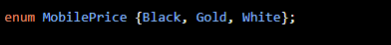
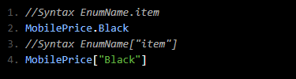
Enum
In the mCart application, a MobilePrice enum can be used to store different prices of the mobile depending on the mobile color.
In the above example, value of first item will be 0 (default value) and subsequent items will have sequential increment from first value.
To get the value from an Enum use one of the following:

Slide 26
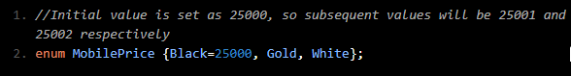
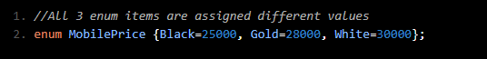
Enum
Enum items can also be initialized with different values than the default value. If a different value is set for one of the variables, the subsequent values will be incremented by 1.
It is even possible to set different values to different Enum items

Slide 27
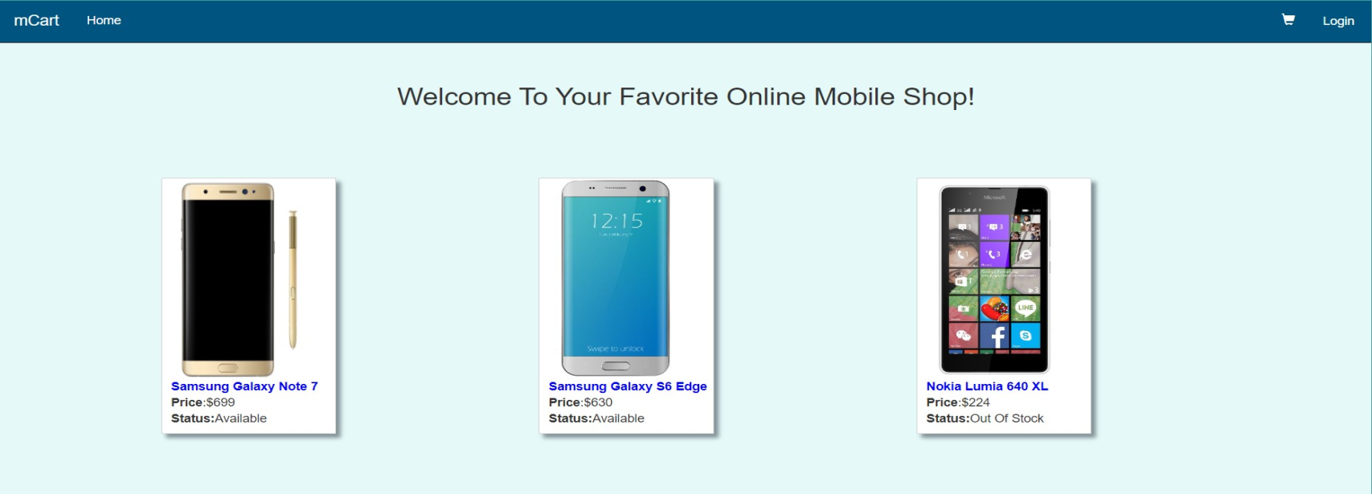
Arrays
Consider the below page of the mCart application that displays the list of mobile phones available. For each mobile in the list, you can see its image, name, price, and availability status.
This requirement is implemented using the concept of Arrays in TypeScript. Let us discuss arrays in TypeScript.

Slide 28
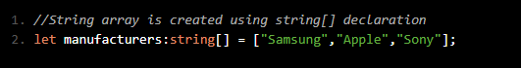
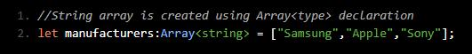
Arrays
An array is used to store multiple values in a single variable. The values stored in an array can be easily accessed using the index position of the data stored in the array.
TypeScript array is an object to store multiple values in a variable with a type annotation. They are like JavaScript arrays.
Arrays can be created using one of the methods given below:
1. Using datatype[] declaration
2. Using Array<type> declaration

Slide 29
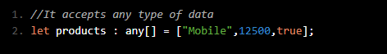
Arrays
3. Using any[] declaration
A TypeScript array defined with a specific type does not accept data of different types.
TypeScript arrays can be accessed and used much like JavaScript arrays.

Slide 30
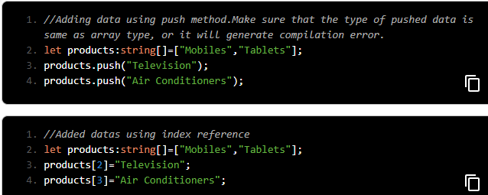
Arrays
JavaScript Array has several useful properties and methods to access or modify an array. All the JavaScript array methods are supported in TypeScript also. Few examples are given below.
Value can be added dynamically to an array using either the push method or the index reference.

Slide 31
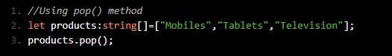
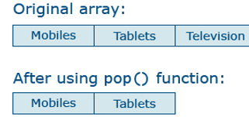
Arrays
Data can be removed from an array using the pop method or splice method

Slide 32
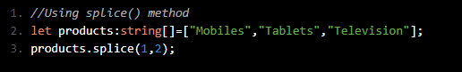
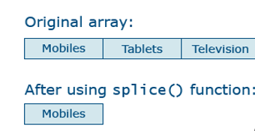
Arrays
The splice function removes the item from a specific index position.

Slide 33
Tuple
In the mCart application, tuples can be used to store product details that require more than one type of data.
The order of the first set of data entries while initializing a tuple variable should be the same as the order in which the type is declared in a tuple.
A developer can initialize only one entry as per TypeScript data restriction length policy.
A compilation error will be thrown in below two cases:
if you are trying to assign multiple entries in the first initialization.
if you try to initialize different datatypes directly to the tuple declared variable.
In order to overcome the above-mentioned compilation errors, use the push() method.
Example:

Slide 34
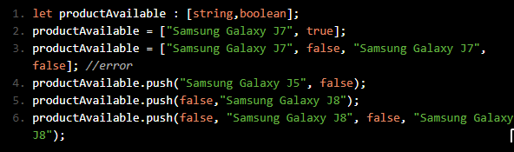
Tuple
In the above example, the error is due to multiple declarations in the first initialization which violates the length restriction policy. To avoid this, the push method can be used as shown in the code.

Slide 35
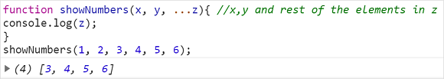
Rest and spread operators
The all new operator in ES6 with triple dots … is called rest or spread operator and can be used in two different contexts:
Rest – as the name indicates serves as a placeholder to hold rest of the parameters passed in a function.
Z with triple dots … serves as a variable length array which can hold any number of elements at run time.

Slide 36
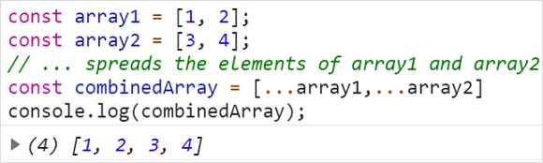
Rest and spread operators
Spread – helps in spreading out the elements of the array to new variable.
The triple dots … in the above example before the arrays spread the content of them in the new array.

Slide 37
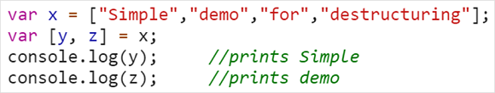
Using Destructuring
ES6 destructuring gives a syntax which makes it easy to create objects based on variables.
It also helps to extract data from an object or array. Destructuring works even with the rest and spread operators.
Example:

Slide 38
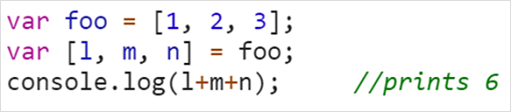
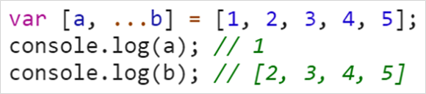
Using Destructuring
Using Destructured Values
Using Rest operator in destructuring.
In this case variable b will be an array with rest of the parameters.

Slide 39
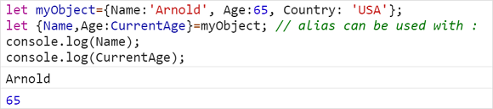
Using Destructuring
Destructuring objects: In the below example an object is destructured into individual variables
An alias CurrentAge is used for Age

Slide 40
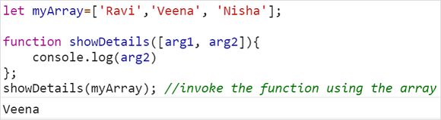
Destructuring in Functions
Destructuring in functions: This works very well with arrays and object for selecting specific information
Array destructuring in functions:

Slide 41
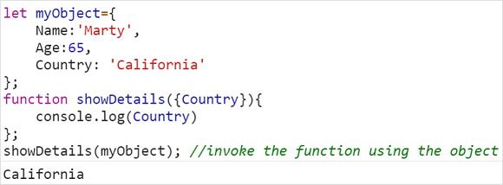
Destructuring in Functions
The first two array elements have been destructured into individual function parameters.
Object destructuring in functions:
The property Country of the object has been destructured and captured as a function parameter.

Slide 42
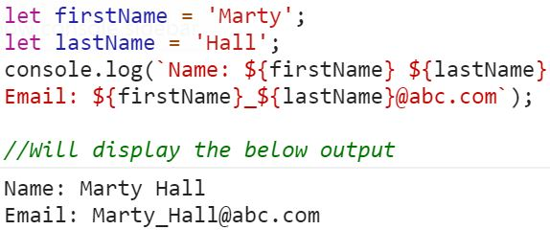
Template Literals
Template Literals
A template literal is a new type of string literal in ES6.
It can span multiple lines and interpolate expressions to include their results.
Example:
The variables are accessed using ${} notation.

